Slide 1
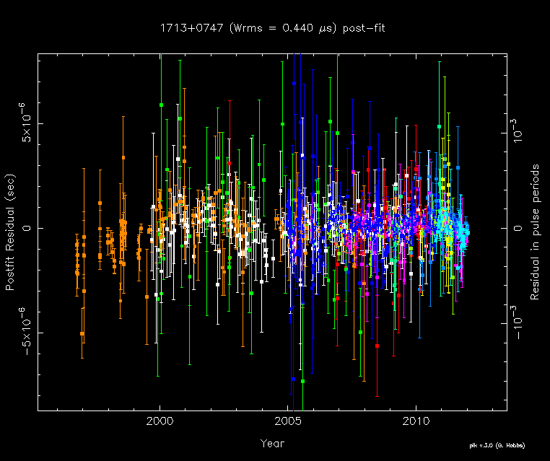


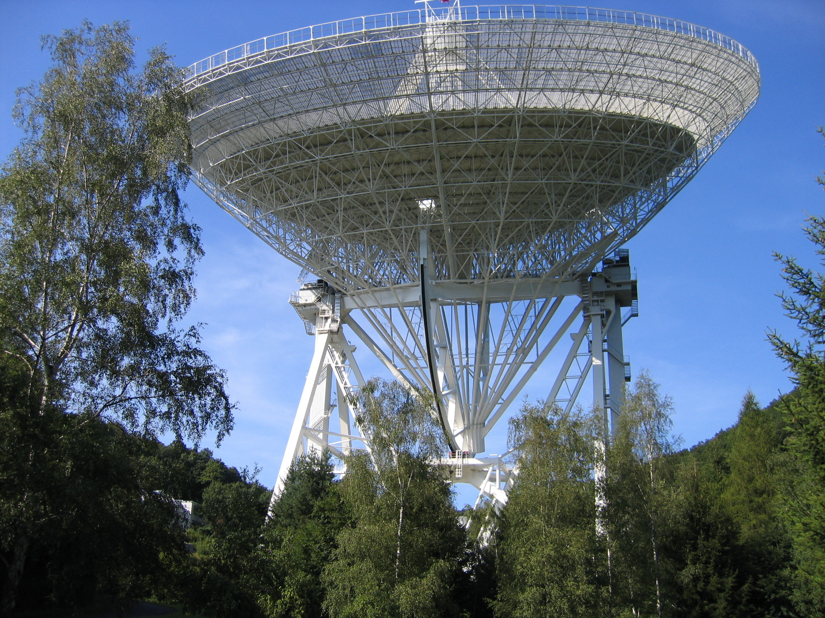
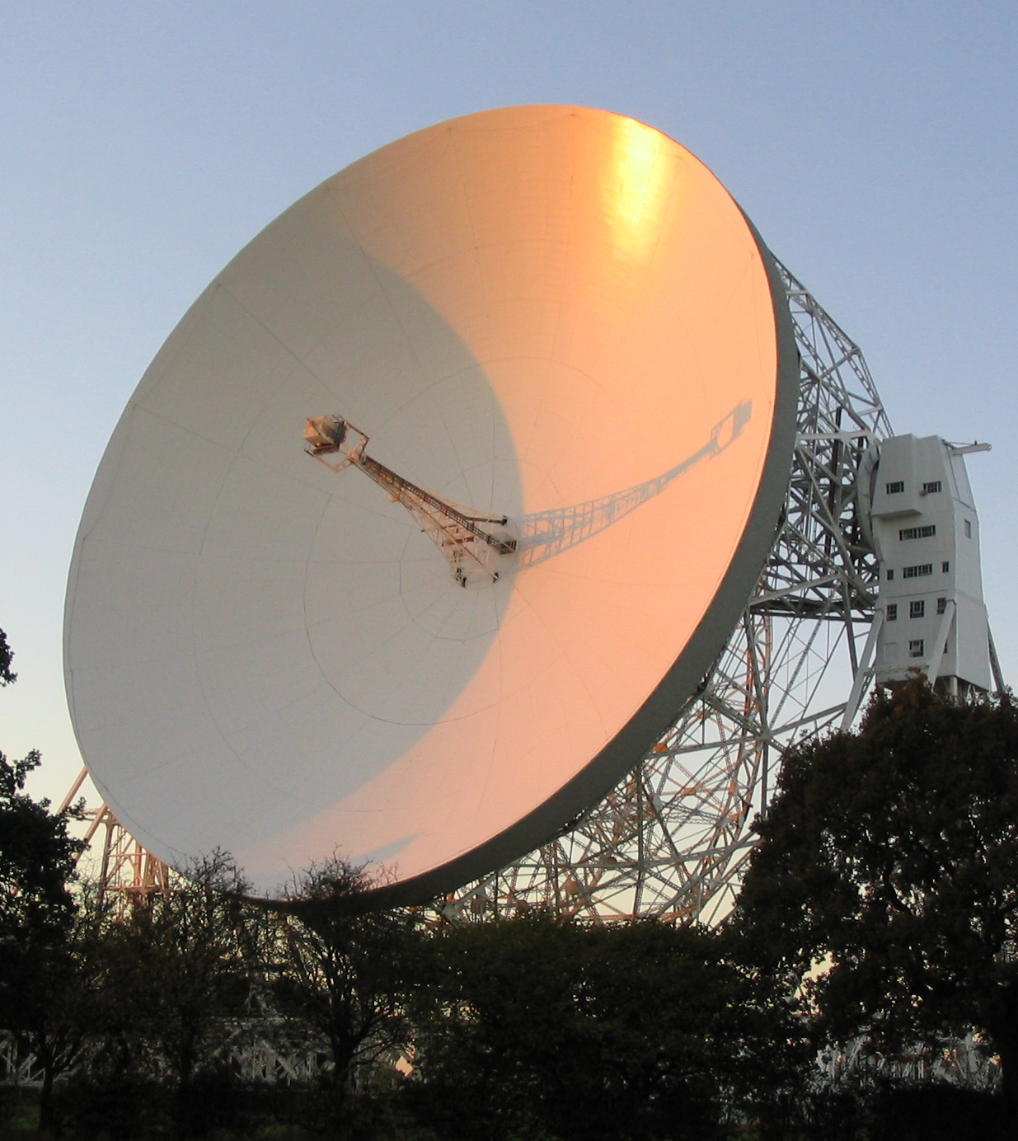
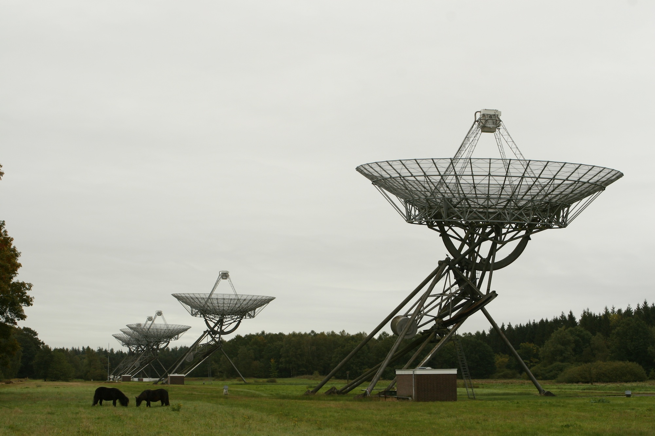
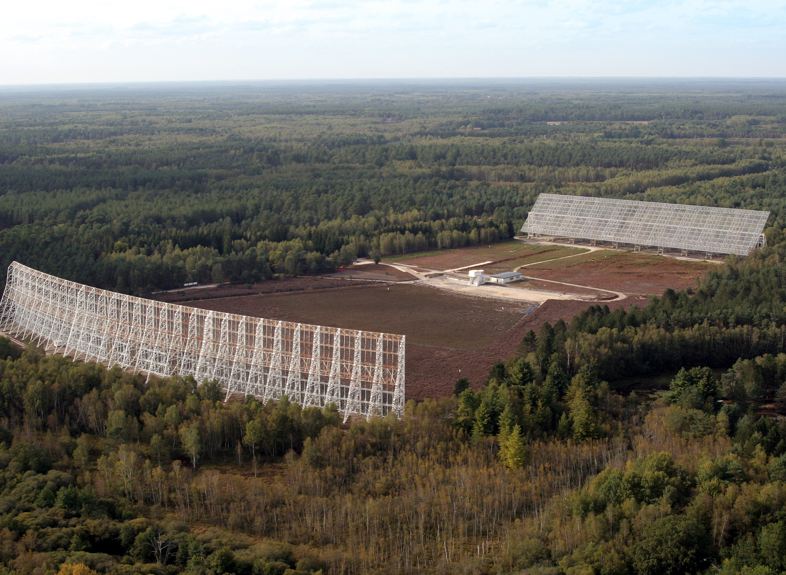
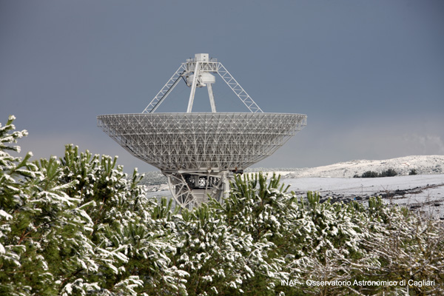
Combining multi-telescope, multi-frequency
data sets for the EPTA…. and IPTA!
Gemma Janssen, JBCA/EPTA

Slide 2
Combining multi-telescope, multi-frequency data
-EPTA timing working group
-EPTA data sets
-examples: combining multi-telescope,
multi-frequency data

Slide 3
Combining multi-telescope, multi-frequency data
The EPTA timing working group:
Nicolas Caballero, David Champion, Gregory Desvignes
Joris Verbiest, Gemma Janssen
(Cees Bassa, Patrick Lazarus)
Main task: keeping timing up to date, providing TOAs
for papers/projects/IPTA/database (see TOAST poster)
Updating clock files
Source selection, Source lists per telescope (KJ’s talk),
New sources
Notes:
Refer to database poster, KJ’s poster

Slide 4
The EPTA: Combining data sets
EPTA timing group 2012:
3 papers on EPTA long-term data sets
(see poster by N. Caballero)
EPTA status, combining manual, timing solutions
DM variations, profile evolution
Noise analysis & timing stability
Asap: data set provided to the IPTA!

Slide 5
The EPTA: Observations
First generation: long-term timing
Telescope | Instr | T(yr) | Npsrs | Freq(GHz) | BW(MHz)
Effelsberg | EBPP | 16 | 15 | 1.4, 2.6 | 80
Lovell | A+DFB | >15, 3 | 15 | 0.6, 1.4 | 64, 384
Nançay | BON128 | 12 | 25 | 1.4, 2.1 | 128
WSRT | PuMaI | 12 | 15 | 0.35, 0.8, 1.4, 2.3 | 80
Next generation: improvements
Telescope | Instr | T(yr) | Npsrs | Freq(GHz) | BW(MHz)
Effelsberg | Asterix | 1.25 | 25+ | 1.4, 2.6 | 200, 140
Lovell | Obelix | 1.25 | 25+ | 1.4 | 400
Nançay | BON512 | 1 | 25+ | 1.4, 2.1 | 512
WSRT | PuMaII | 5 | 25+ | 0.35, 1.4, 2.3 | 80, 160

Slide 6
The EPTA: Source list
About 20 pulsars selected as “Priority 1”: observed at all telescopes,
as many frequencies as possible; longest data sets available
J0613-0200, J1012+5307, J1024-0719, J1600-3053, J1640+2224,
J1643-1224, J1713+0747, J1730-2304, J1744-1134, B1855+09,
J1909-3744, B1937+21, J2145-0750, J2317+1439
Another ~10 pulsars selected as “Priority2”: observed at most
telescopes, multi-frequency if possible. New sources like Fermi MSPs
J0023+0923, J0030+0451, J0218+4232, J0751+1807, J1022+1001,
J1738+0333, J1741+1351, J2010-1323, J2017+0603, J2043+1711
KJ Lee’s talk on Thursday!
Notes:
Pulsars where observed, explain about the source list. Can change, new sources constantly added.observed frequencies?

Slide 7
The EPTA: solutions
Pulsar | Effelsberg | Jodrell | Nancay | WSRT | Comb
0613-0200 | 1.9us(13yr) | 5.8us(3yr) | 1.1 (7yr) | 2.3us (11yr) | 1.5 (13yr)
1022+1001 | 2.8us(13yr) | 2.0us(3yr) | 1.7 (7yr) | 1.6us(11yr)
1024-0719 | 1.8us (6yr) | 3.3us(3yr) | 1.1 (7yr) | 3.1us(3yr) | 1.8 (7yr)
1713+0747 | 0.5us (13yr) | 0.6us(3yr) | 0.4us(7yr) | 0.7us(11yr) | 0.4us(13yr)
1713+0747 New instr | 0.17us (0.9yr) | 0.20us (1yr) |  | 0.23us (5yr)

Slide 8
Combining data sets; what can you expect?

Slide 9
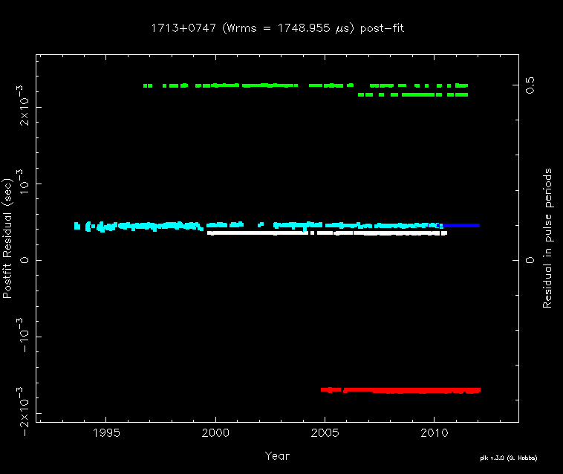
The EPTA: Combining data sets
PSR J1713+0747: Eff(2), JB (afb+dfb), WSRT (3), NCY (2)
Notes:
Green: Effelsberg EBPP.
Light blue: Jodrell AFB. Significant lower quality, so for most IPTA purposes this is not helpful to include.
Dark blue: Jodrell DFB, 3 years only
White: WSRT puma1
Red: Nancay Bon

Slide 10
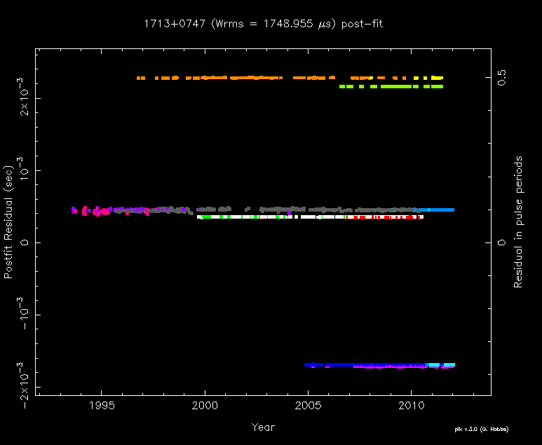
The EPTA: Combining data sets
PSR J1713+0747: Eff(2), JB (afb+dfb), WSRT (3), NCY (2)
Notes:
Same plot as previous slide, but now the colors indicate necessary extra jumps: different centre frequency, change in instrument, clock jump
Colors are not necessarily the same in any further plots.

Slide 11
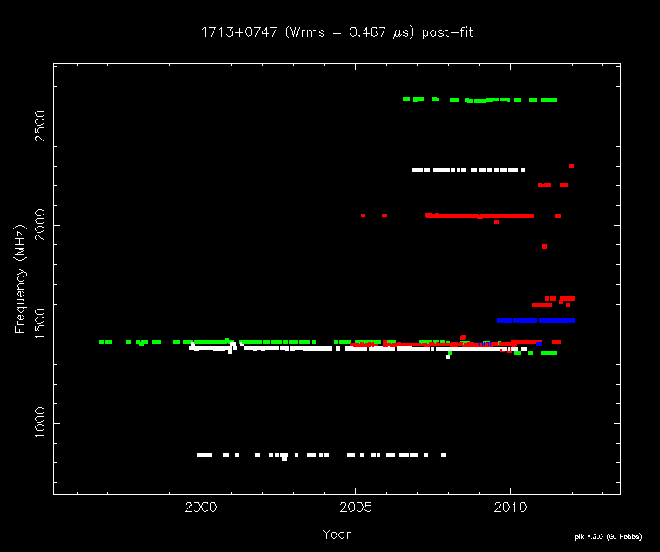
The EPTA: Combining data sets
PSR J1713+0747: Eff(2), JB (dfb), WSRT (3), NCY (2)
Notes:
Time vs frequency. Green: Eff, White: WSRT, Blue: JB, Red: Nancay

Slide 12
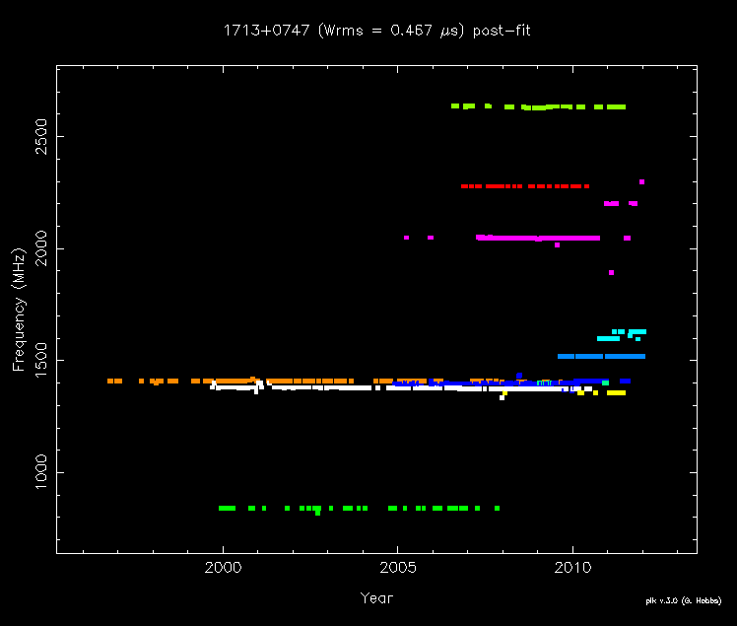
The EPTA: Combining datasets
PSR J1713+0747: Eff(2), JB (dfb), WSRT (3), NCY (2)
Notes:
Time vs frequency. Top three: Eff, WSRT, Nancay. Lband cluster: Nancay, dfb, eff/wsrt/nancay/dfb. 840MHz WSRT.

Slide 13
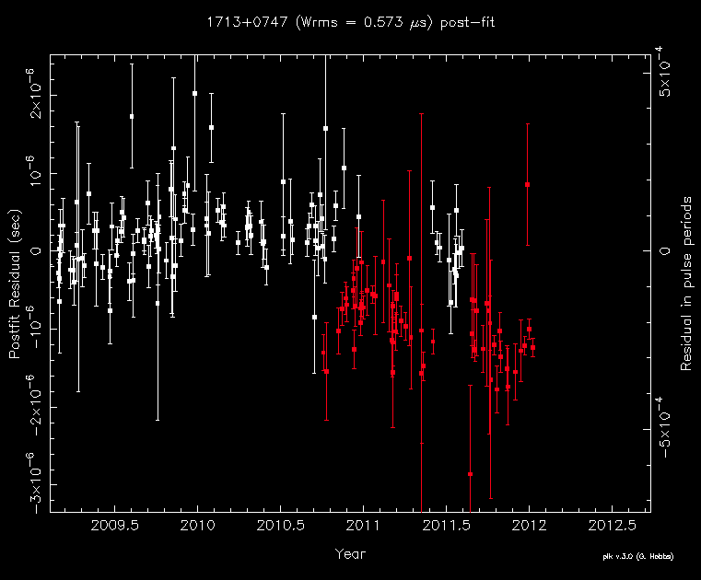
The EPTA: Combining datasets
Nancay configuration change: needs extra jump!
Notes:
Nancay Lband toas; the red toas were made with a different setup and different bandwidth compared to the white toas

Slide 14
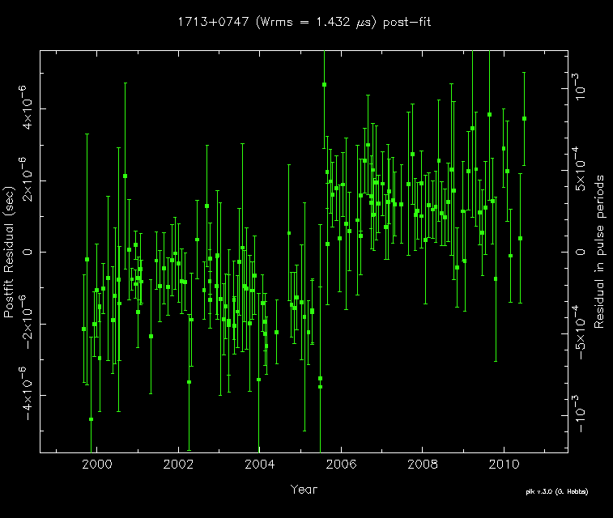
The EPTA: Combining datasets
WSRT clock offset June 2005
Notes:
WSRT clock jump in June 2005 due to a local oscillator change; exact value not known, can only be found by comparing different pulsars vs each other

Slide 15
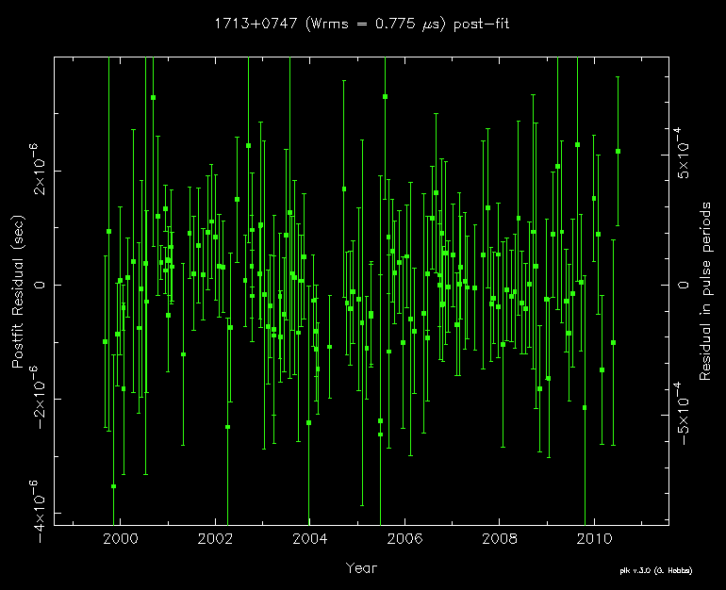
The EPTA: Combining datasets
WSRT clock offset June 2005
Notes:
Same data as previous slide, with clock jump fitted. As the exact value is not known yet and may even be different for different pulsars. We have given all toas after jump an extra flag; result: this dataset is treated as two independent datasets when combined with other data sets.

Slide 16
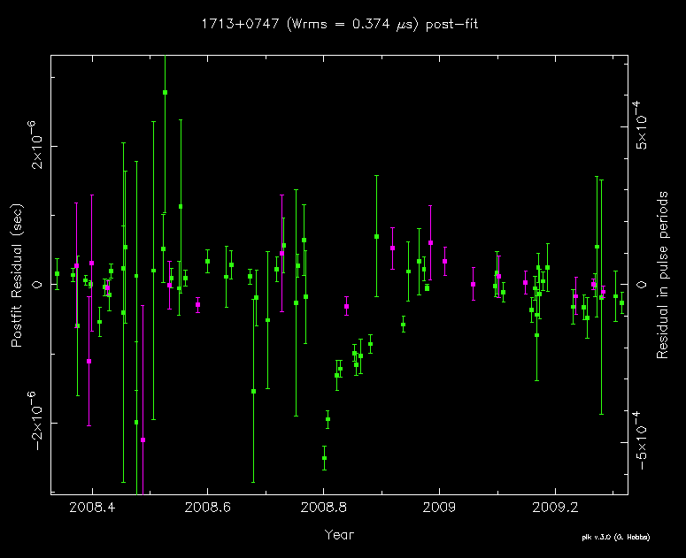
The EPTA: Combining data sets
1713-event October 2008: found in Nancay data
Notes:
Green: Nancay Lband; Purple: Nancay Sband

Slide 17
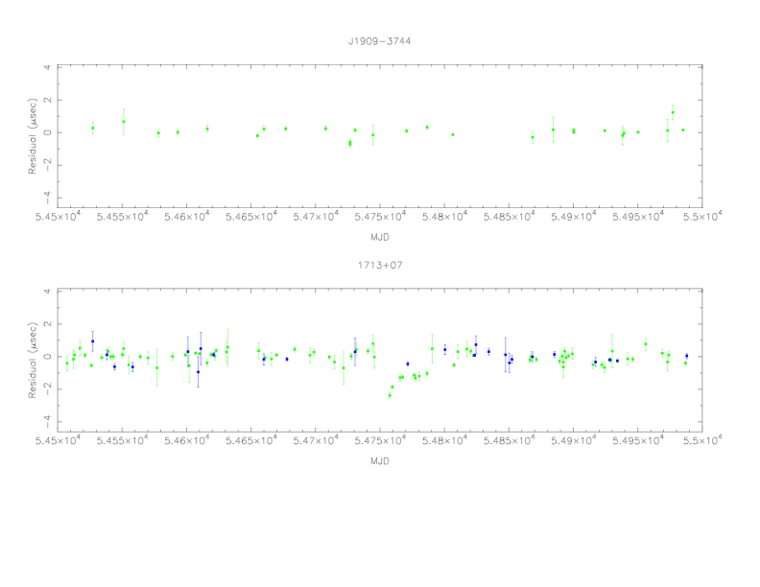
The EPTA: Combining data sets
1713-event: pulsar-dependent. Not seen in J1909-3744
Notes:
Compared with Nancay TOAs from 1909-3744. There it doesn’t show the offset, even with limited toas.

Slide 18
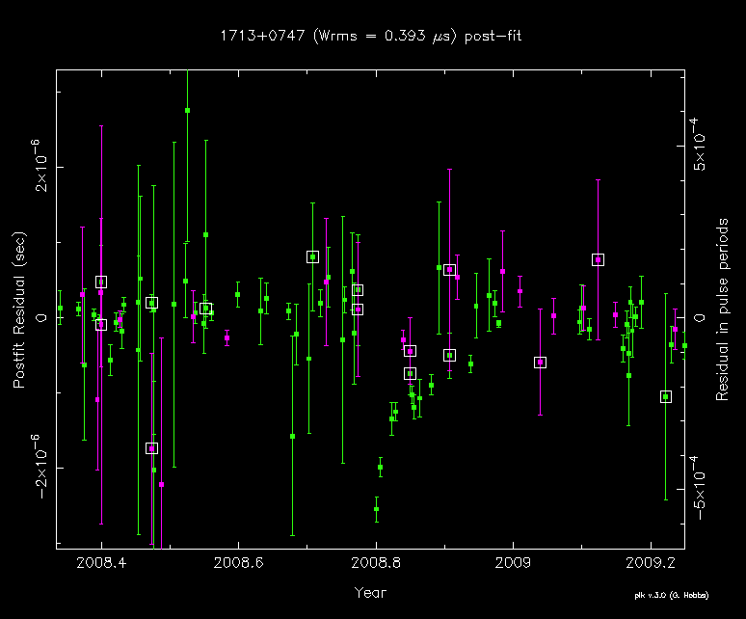
The EPTA: Combining data sets
1713-event: difficult to confirm with EPTA data alone
Notes:
Squares: WSRT puma2 data

Slide 19
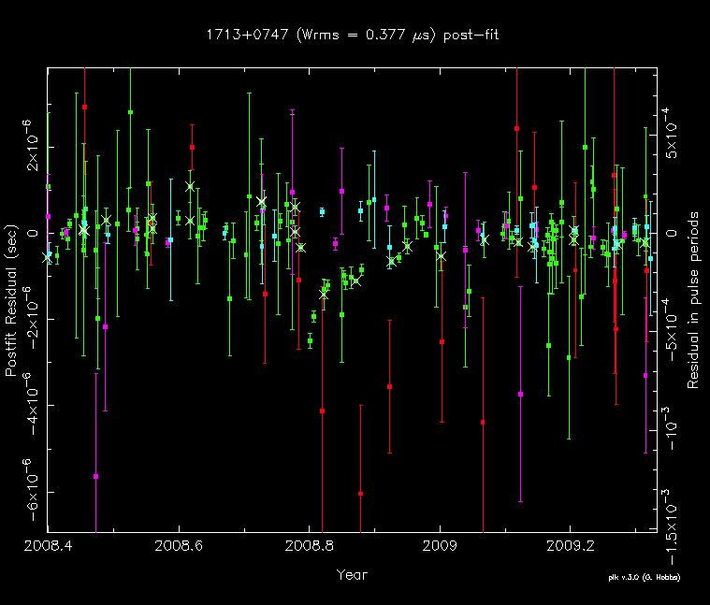
The EPTA: Combining data sets
1713-event: also in PPTA data
Notes:
Green: Nancay, puma1, PPTA Lband
Purple: WSRT and Nancay Sband
Light blue: PPTA 10cm; red: PPTA 50cm

Slide 20
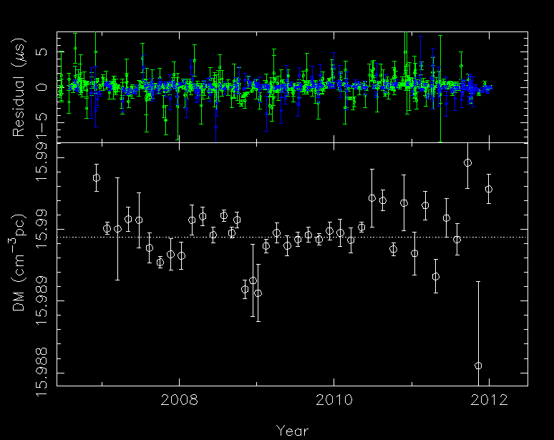
The EPTA: Combining data sets
Work in progress by G. Desvignes with EPTA timing
group, M. Bailes

Slide 21
The EPTA: Combining data sets
Full EPTA combination
Notes:
All EPTA no PPTA

Slide 22
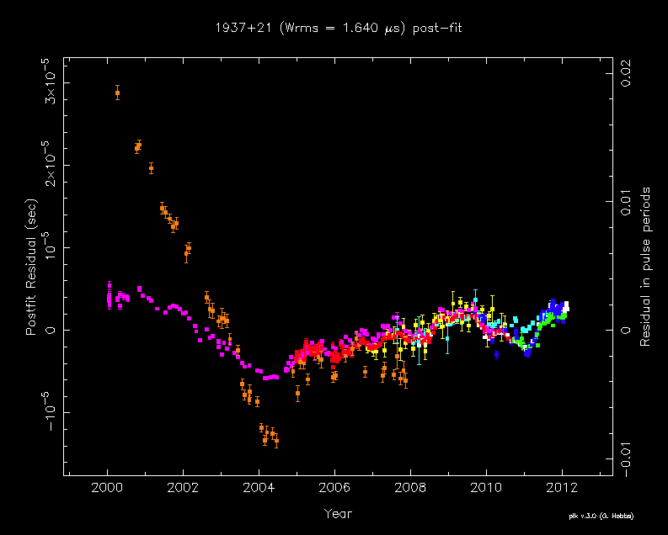
The EPTA: Combining data sets
B1937+21
Notes:
1937 combination, shows clearly that the extra frequencies are very important.

Slide 23
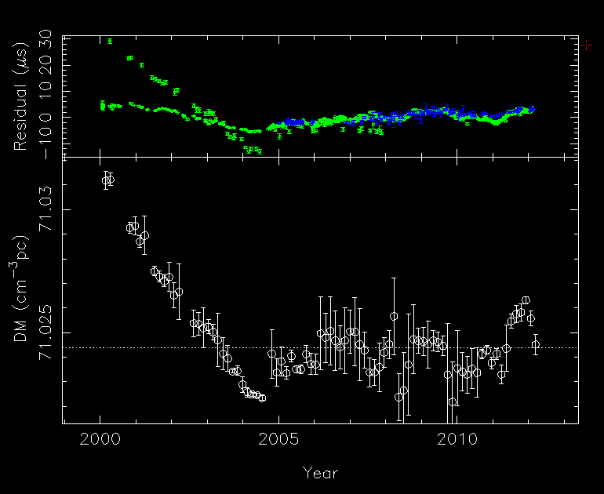
The EPTA: Combining datasets
B1937+21: DM variations
Notes:
1937 combination, shows clearly that the extra frequencies are very important.

Slide 24
The EPTA: Combining data sets
When combining multiple multi-frequency data sets:
-pre-whiten data per frequency band
-determine jumps per frequency band
use only overlapping parts if possible
-search for and include clock jumps
-unwhiten data with jumps fixed
-measure DM variations
-apply DM corrections to TOAs
-include errors on the jumps and DM measurements
on the TOA error
Work in progress! (EPTA timing group; poster: KJ Lee)

Slide 25
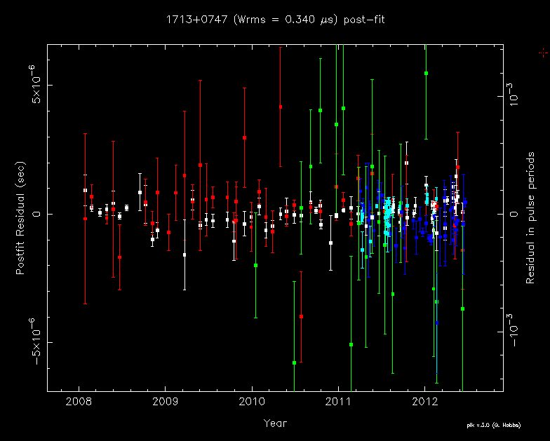
The EPTA: Future data sets
J1713+0747, next-generation

Slide 26
The EPTA: IPTA data sets status
-Re-analysed all long-term data sets from scratch
-combinations to determine jumps and clock offsets
-inserting flags necessary to handle data
-last bits of finetuning now in progress
-we will start having data sets available for IPTA from
mid-July
EPTA is mini-IPTA; combining data sets in an optimal way
is essential for the IPTA
We are ready to start working on the IPTA limit paper!

